Slide 1
Install web server
簡廷因 Ting-Ying Chien
2024.09.10

Slide 2
Outline
Install XAMPP server (windows)
Apache
PHP
MariaDB (MySQL)
Install apache server (linux)

Slide 3
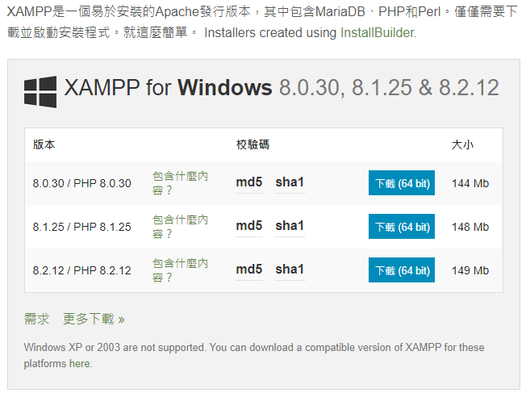

Install server
Download XAMPP
https://www.apachefriends.org/zh_tw/index.html

Slide 4
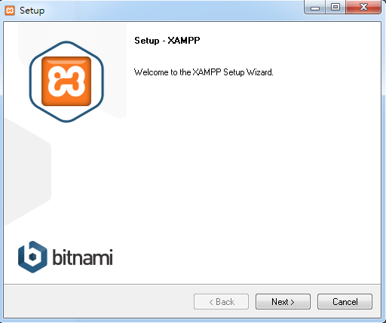
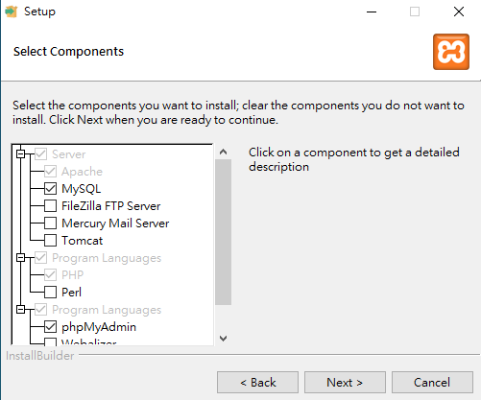
Install server
Apache / MySQL / PHP / phpMyAdmin

Slide 5
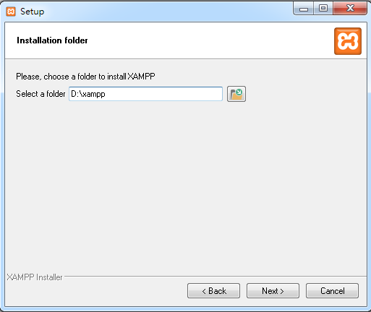
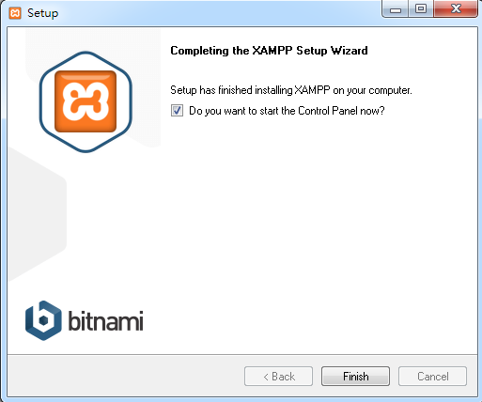
Install server

Slide 6
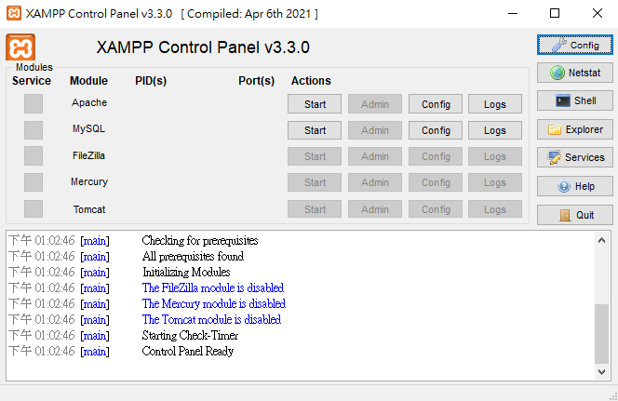
Install server

Slide 7
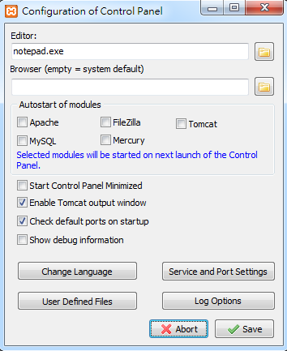
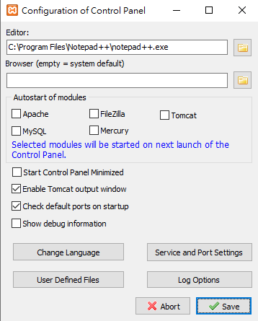
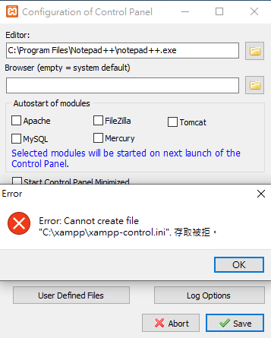
Install server
C:\Program Files\Notepad++\notepad++.exe

Slide 8
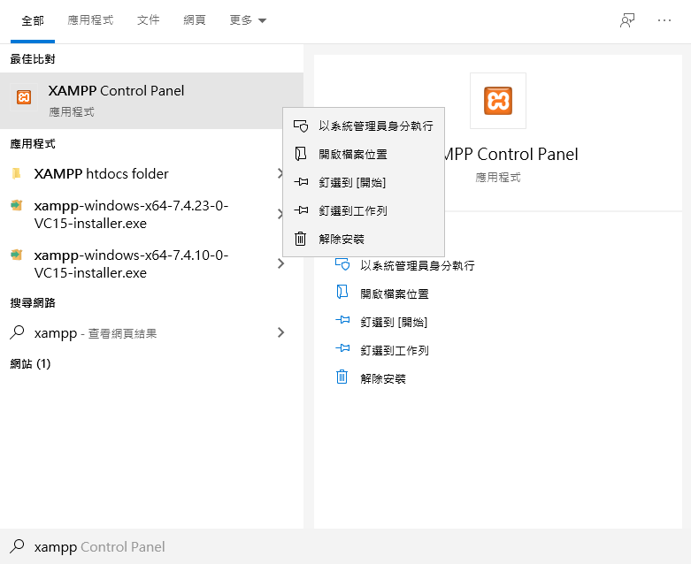
Install server
關掉xampp -> 搜尋xampp->滑鼠右鍵->以系統管理員身分執行

Slide 9
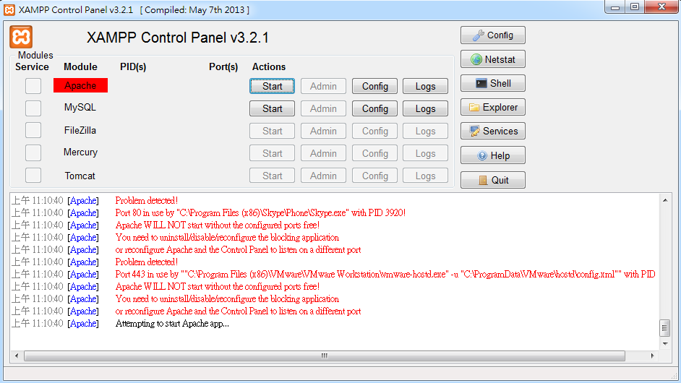
Install server
(optional) Apache Error
Modify config

Slide 10
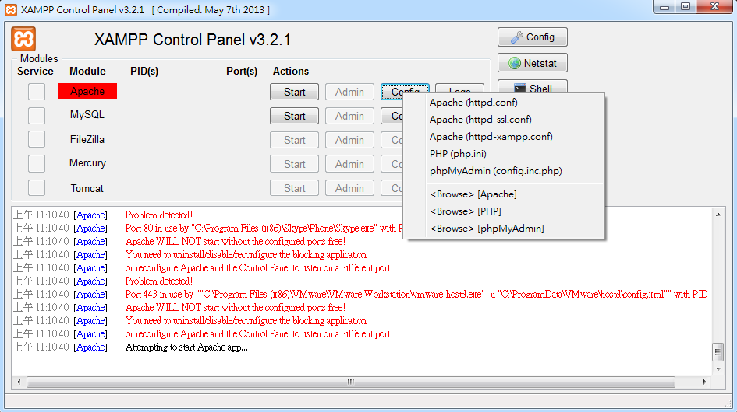
Install server
(optional) Apache Error
Port 80 error -> httpd.conf
Port 443 error -> httpd-ssl.conf

Slide 11
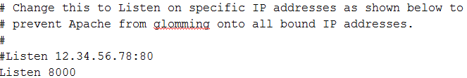
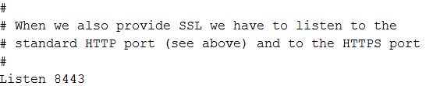
Install server
(optional) Apache Error
httpd.conf
httpd-ssl.conf

Slide 12
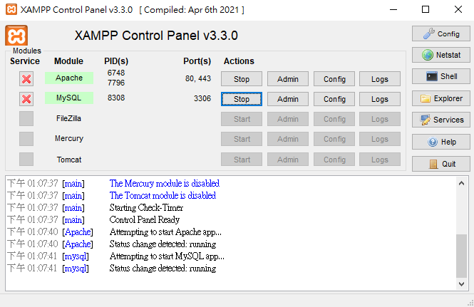
Install server

Slide 13
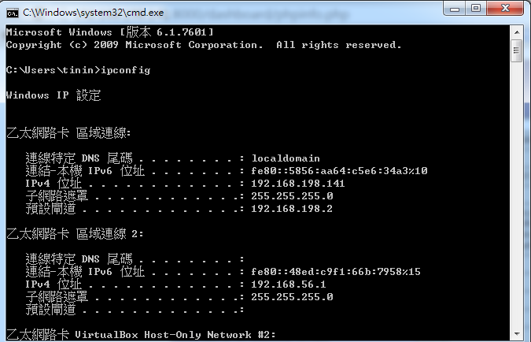
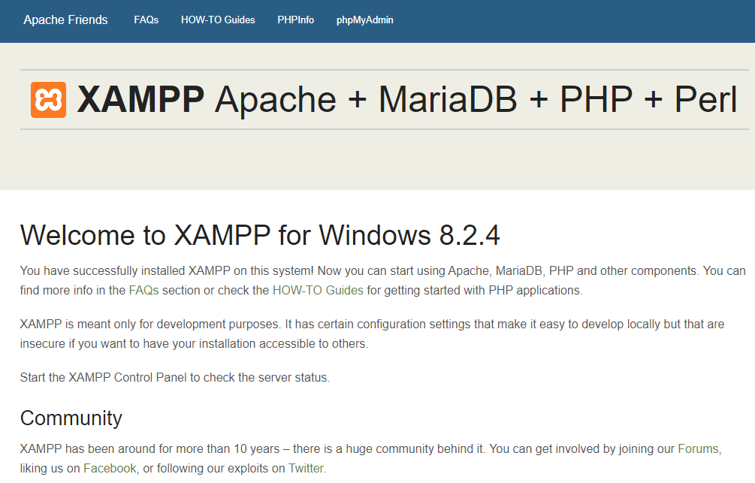
Install server
Server URL:
http://YOURIP:PORT/ or http://localhost:PORT
開始->執行->cmd->ipconfig
1008教室 : 140.138.144.xx ~ 140.138.144.xx

Slide 14
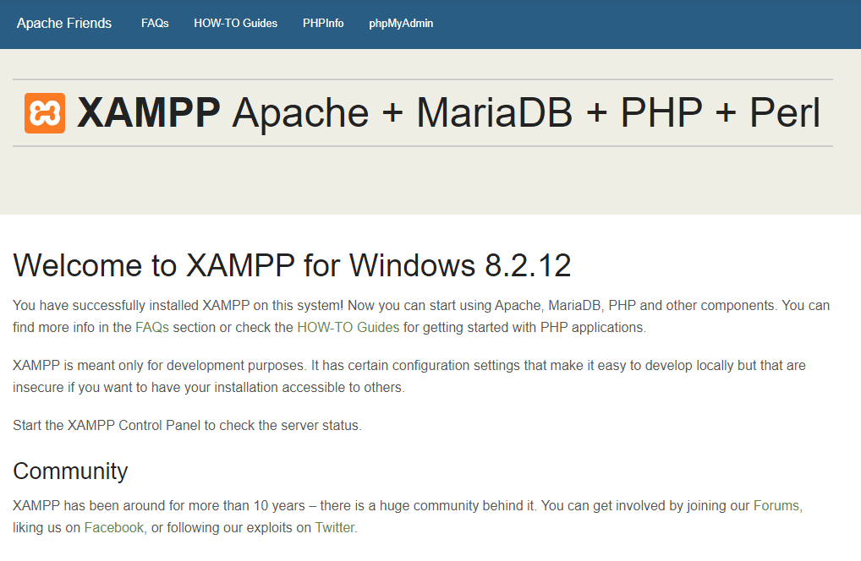
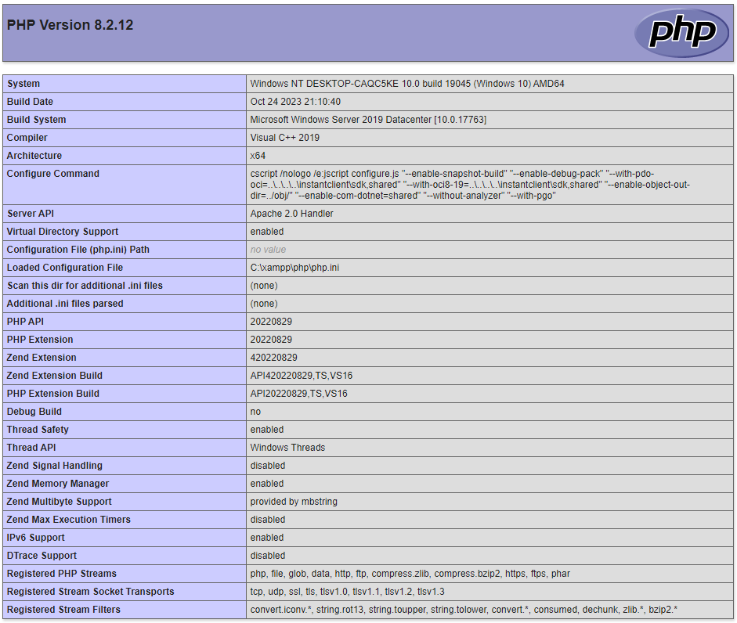
Install server
Check PHP

Slide 15
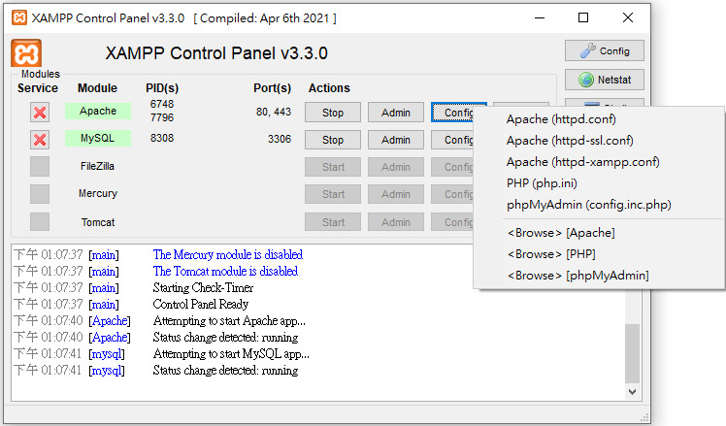
Install server
Apache configuration
INSTALL DIR/apache/conf/httpd.conf
ServerRoot #安裝位置
Listen # Port 預設80
DocumentRoot #網頁檔案位置
INSTALL DIR/htdocs #預設網頁檔案位置
C:/xampp/htdocs

Slide 16
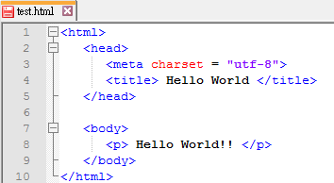
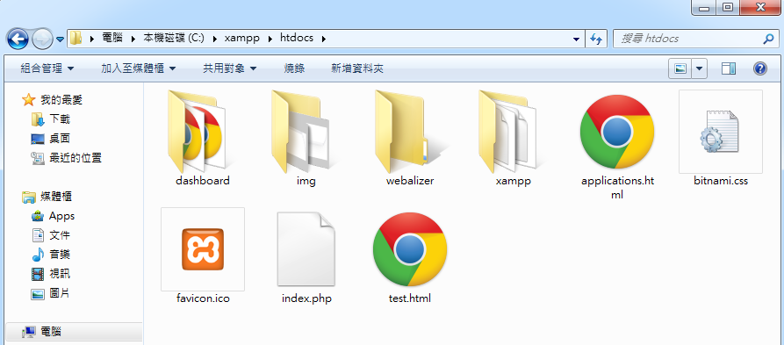
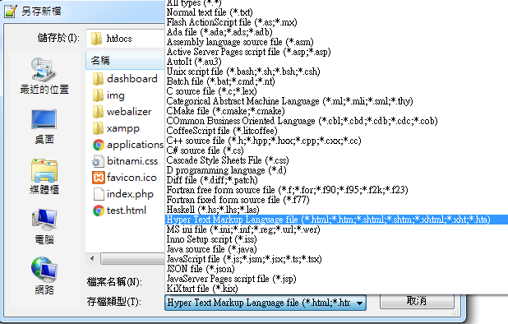
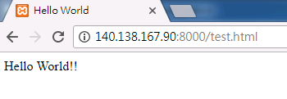
Install server
Example: test.html
<html>
<head>
<meta charset = "utf-8">
<title> Hello World </title>
</head>
<body>
<p> Hello World!! </p>
</body>
</html>
Test Server
“存檔類型”要改成”html”

Slide 17
Install server
Setup 404 Error
Windows (Xampp)
INSTALL DIR/apache/conf/httpd.conf
Add file : INSTALL DIR/htdocs/missing.html
Linux (apache)
/etc/apache2/conf-available/localized-error-pages.conf
Add file : /var/www/html/missing.html
#ErrorDocument 404 /missing.html
ErrorDocument 404 /missing.html
(For XAMPP)
Include conf/extra/httpd-multilang-errordoc.conf
#Include conf/extra/httpd-multilang-errordoc.conf

Slide 18
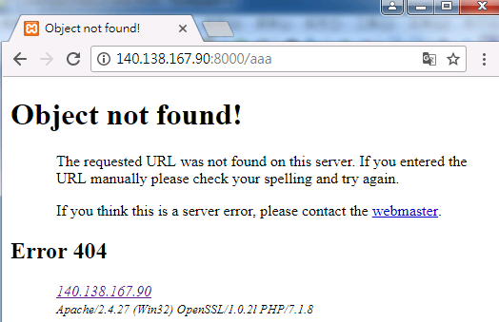
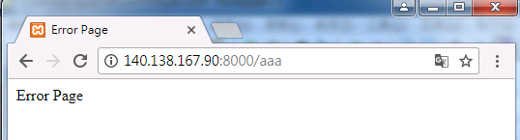
Install server
Example: missing.html
<html>
<head>
<meta charset = "utf-8">
<title> Error Page </title>
</head>
<body>
<p> Error Page </p>
</body>
</html>

Slide 19
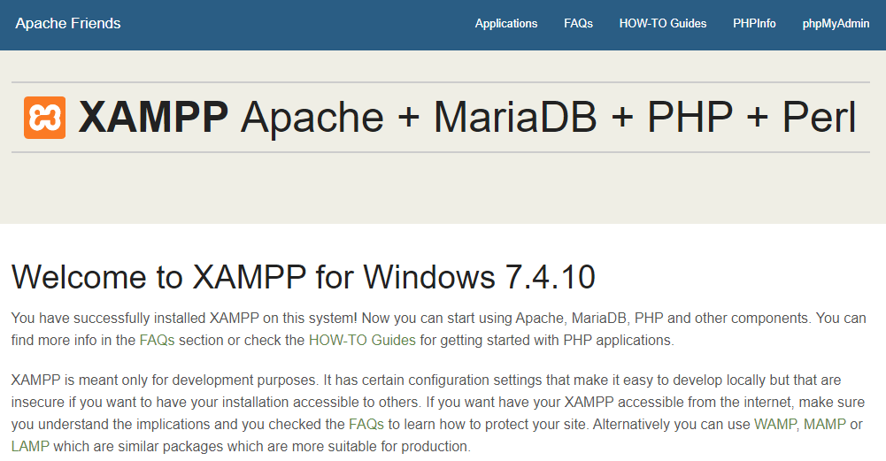
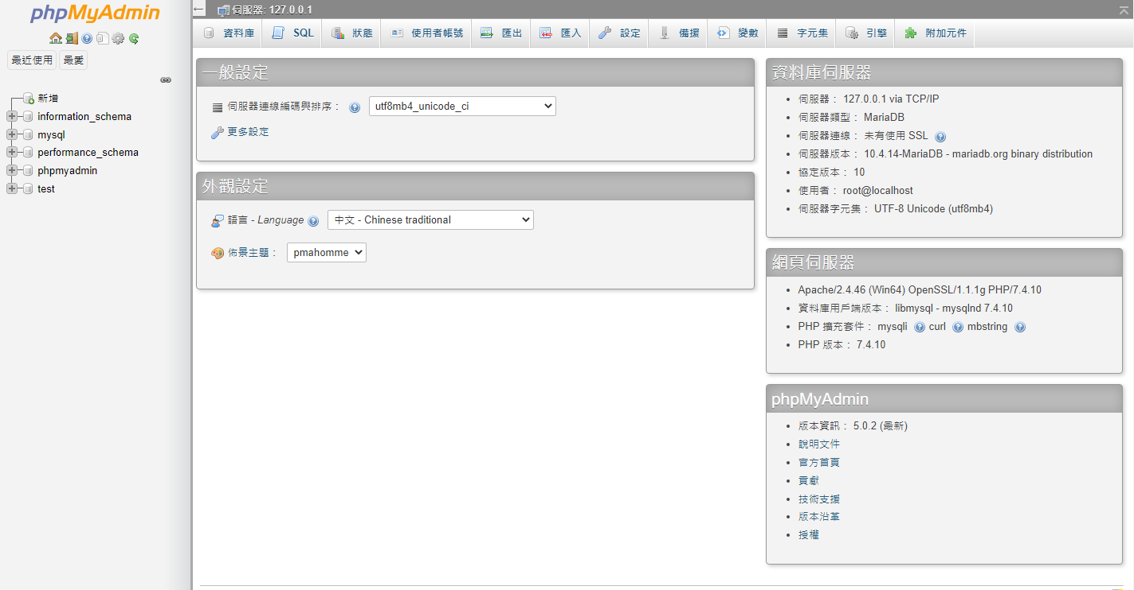
Install server
Check MySQL
http://YOURIP:PORT/phpmyadmin

Slide 20
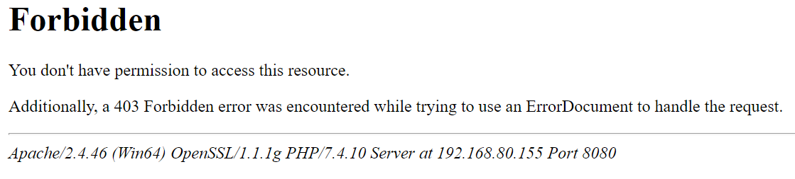
Install server
(optional) Access forbidden!
Modify httpd-xampp.conf

Slide 21
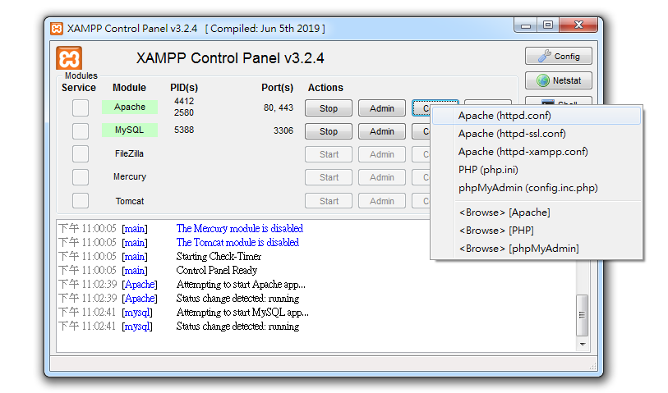
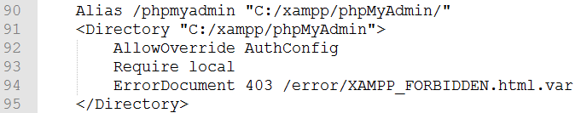
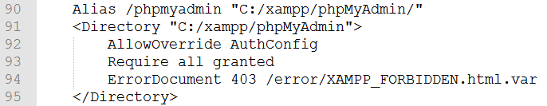
Install server
(optional) Access forbidden!
After modify the file, restart apache

Slide 22
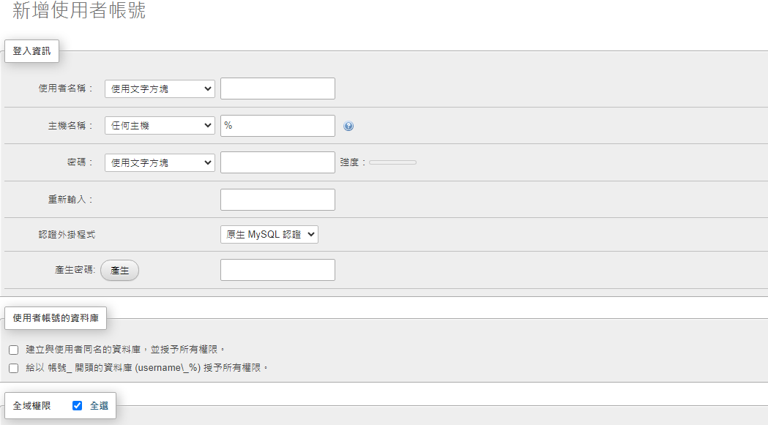
Install server
新增使用者
使用者 ->新增使用者帳號(管理者)

Slide 23
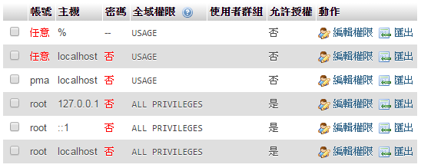
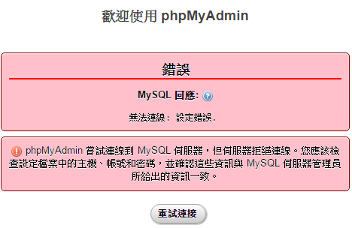
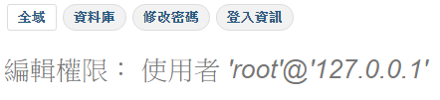
Install server
Set root password
使用者 -> root -> 編輯權限 ->修改密碼
主機 127.0.0.1, ::1, localhost 都要改

Slide 24
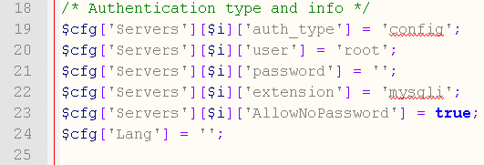
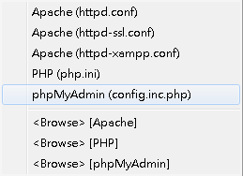
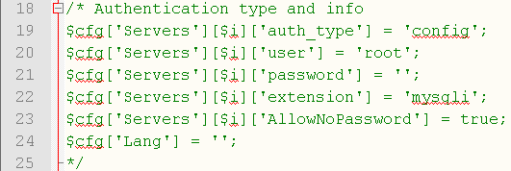
Install server
Login with password
Modify phpMyAdmin (config.inc.php)

Slide 25
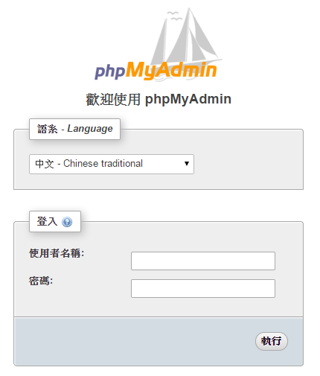
Install server

Slide 26
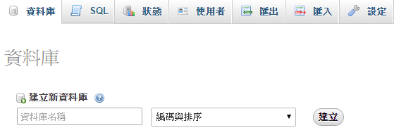
Install server
Create a database

Slide 27
No-IP
Sign in and confirm
https://www.noip.com/

Slide 28
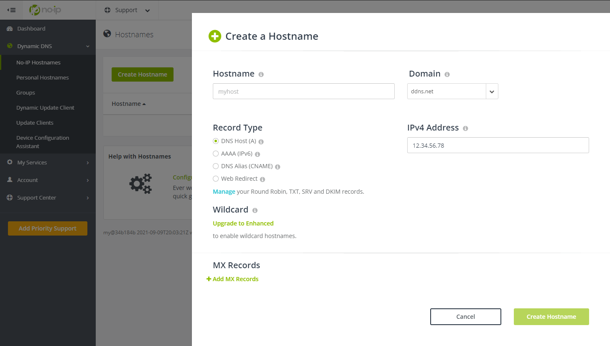
No-IP
Add a host

Slide 29
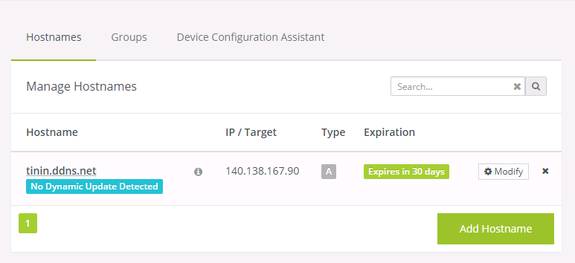
No-IP

Slide 30
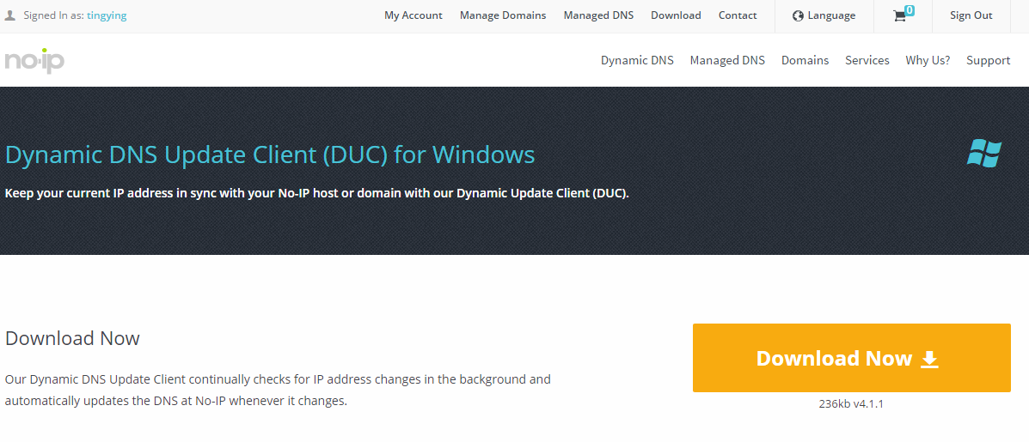
No-IP
Download dynamic DNS update client
http://www.noip.com/download?page=win
浮動IP使用

Slide 31
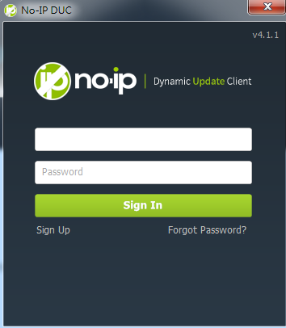
No-IP
Login DUC

Slide 32
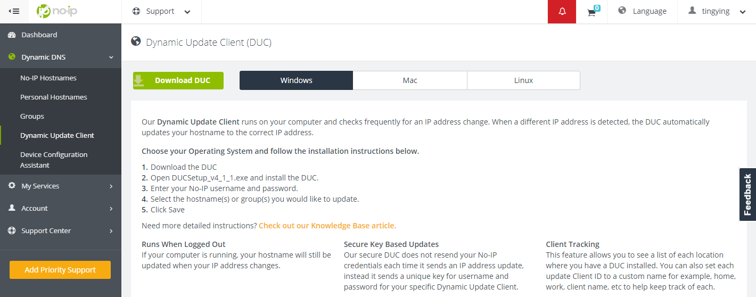
No-IP

Slide 33
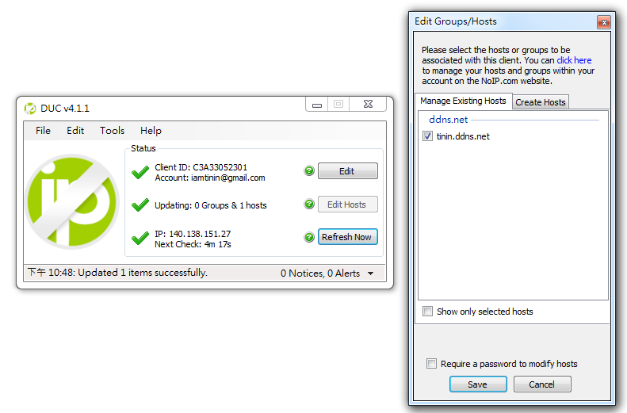
No-IP
DUC
Edit Hosts

Slide 34
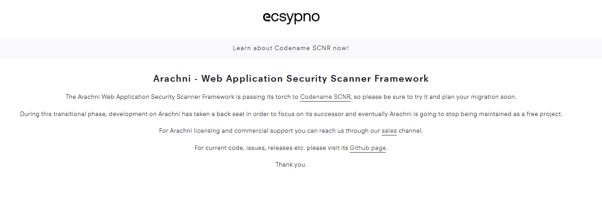
Arachni
Arachni
Web security scanner framework
https://www.arachni-scanner.com/
http://140.138.144.108:5000/sharing/tYNgLTnxy

Slide 35
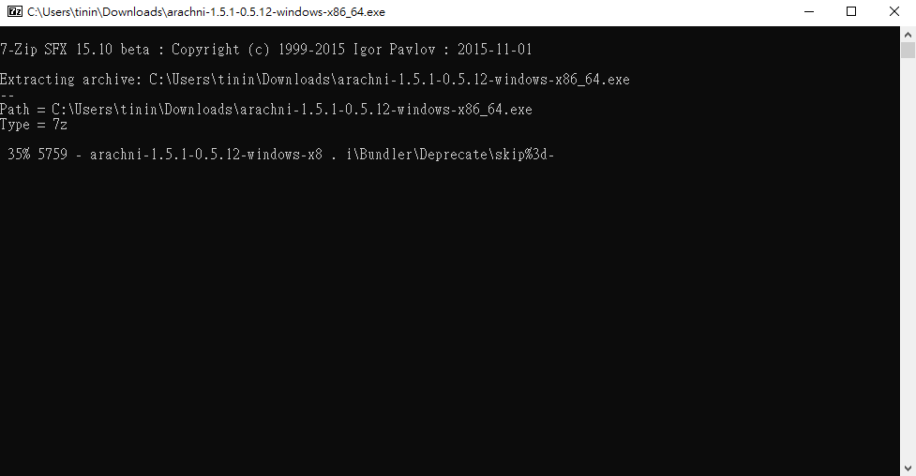
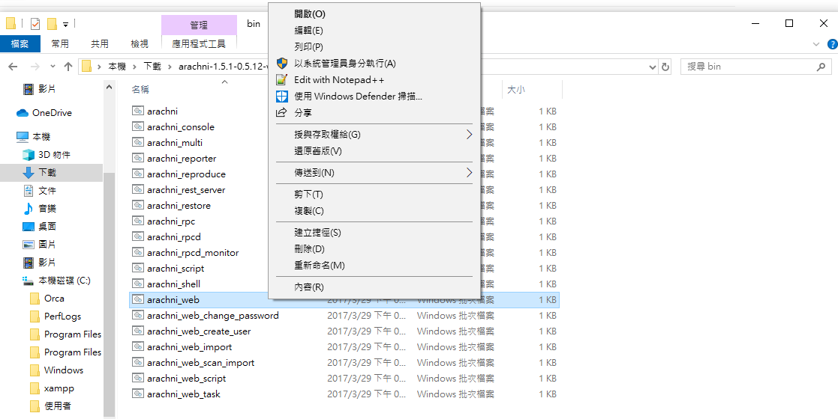
Arachni
arachni-1.5.1-0.5.12-windows-x86_64\bin

Slide 36


Arachni
http://localhost:9292
E-mail: admin@admin.admin
Password: administrator

Slide 37


Arachni

Slide 38

Arachni

Slide 39
Q&A

Slide 40
Install apache server (linux)

Slide 41

Install apache server (linux)
Download Ubuntu 22.04
Vmware Player
Create a New Virtual Machine

Slide 42


Install apache server (linux)
Personal information
User name
Password
Install Location
Please select D:\Web\

Slide 43


Install apache server (linux)
Specify Disk Capacity
40GB
Finish
Check Network Adapter : NAT

Slide 44

Install apache server (linux)

Slide 45

Install apache server (linux)

Slide 46

Install apache server (linux)
Login
To return to your computer, press Ctrl+Alt

Slide 47
Install apache server (linux)
mkdir public_html #建立資料夾
mkdir html
sudo –s #變更使用者為root
apt-get update #更新套件資料庫
apt-get install openssh-server #安裝ssh server

Slide 48



Install apache server (linux)
Connect to server
mobaxterm
ifconfig #查詢server IP

Slide 49
Install apache server (linux)
sudo –s #變更使用者為root
apt-get install vim #安裝vim 文字編輯器
apt-get install apache2 #安裝apache server

Slide 50
Install apache server (linux)
Setup apache
Add server name
Make user directory available
Default : ~/public_html
echo "ServerName localhost" | sudo tee /etc/apache2/conf-available/fqdn.conf
ln -s /etc/apache2/conf-available/fqdn.conf /etc/apache2/conf-enabled/fqdn.conf
cd /etc/apache2/mods-enabled/
ln -s ../mods-available/userdir.conf .
ln -s ../mods-available/userdir.load .
apachectl restart

Slide 51
Install apache server (linux)
Setup apache
Alias
cd /etc/apache2/sites-available
vim tmp.conf #進入後按i開始編輯
cd /etc/apache2/sites-enabled/
ln –s /etc/apache2/sites-available/tmp.conf .
apachectl restart
Example: tmp.conf
Alias /tinin "/home/tinin/html"
<Directory "/home/tinin/html">
Options +ExecCGI #是否可執行cgi檔
AllowOverride None #是否讀取.htaccess檔內容(通常為rewrite)
Require all granted #所有請求都同意
DirectoryIndex index.html
</Directory>

Slide 52

Install apache server (linux)
Test
su –l YOURID
cd public_html
vim test.html
Example: test.html
<html>
<head>
<meta charset = "utf-8">
<title> Hello World </title>
</head>
<body>
<p> Hello World!! </p>
</body>
</html>
YOUR IP
YOUR ID

Slide 53

Install apache server (linux)
Upload files by Filezilla

Slide 54

Install apache server (linux)
Test
su –l YOURID
cp ~/public_html/test.html ~/html/
Example: test.html
<html>
<head>
<meta charset = "utf-8">
<title> Hello World </title>
</head>
<body>
<p> Hello World!! </p>
</body>
</html>
YOUR ALIAS ID

Slide 55
Install apache server (linux)
Download Vmware Player network configuration
https://sites.google.com/site/ninety9namesblogspotcom/vmnetcfg_VMware_Player_6.0.3.rar?attredirects=0&d=1
Copy vmnetcfg.exe and vmnetcfglib.dll to Vmware Player directory

Slide 56




Install apache server (linux)
Open vmnetcfg.exe
VMnet8 ->NAT Settings->add
Port : 80 (web server)
Port : 22 (ssh server)
YOUR VIRTUAL IP

Slide 57


Install apache server (linux)
開始->執行->cmd
ipconfig /all
YOUR PHYSICAL IP: PORT

